Slide 1

Author: Felix Weigl
V1 – Feb 2025
Terraform Training

Slide 2


Agenda
Terraform Overview
Terraform Basics
Variables and Iteration
Terraform Advanced
Terragrunt Introduction

Slide 3
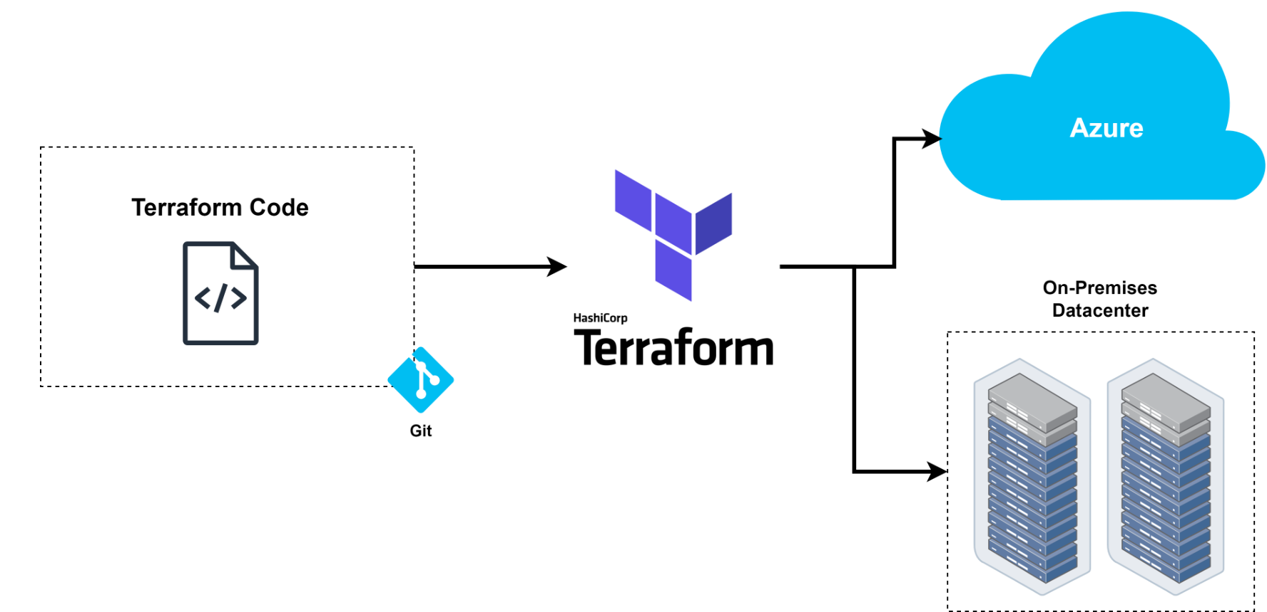
Terraform Overview
IaC
Infrastructure as Code
Notes:
Avoid manual configuration to enforce consistency.
Mail server example.
Scalable.
Versioning.
Code becomes valuable and worth protecting.
Error prevention: Avoid manually configuring five servers.
Flexible.
Lintable (manual configuration not possible).
Reusable! Set it up once, then simply configure it as needed.
Terraform handles the work for us and evaluates the code.

Slide 4


Terraform Overview
Provisioning
Configuring
Notes:
In a home lab, you should clearly separate: Ansible for configuration and Terraform for infrastructure setup.
Stateful
Terraform builds infrastructure.
It also handles the teardown of VMs, etc.
Files are dynamic when users make changes.
API CALLS!!! Terraform handles API calls, while Ansible uses SSH. Both have a low footprint.

Slide 5
Terraform Basics
Provider
"Plugins" or "Providers" of various Resources and Data Sources
HCL
Hashicorp Configuration Language
Resource
Infrastructure/Resource to be created.
Data Source
Data to be retrieved/read from an infrastructure.
Outputs
Any return values to be processed or output in the Terraform code.

Slide 6
Terraform Basics
Input Variables
Variables to populate parameterized code.
Locals
On-the-fly "variables" (modifying existing vars/returns).

Slide 7
Terraform Basics
Hands On
Notes:
01-basic
02-vars

Slide 8
Terraform Advanced
terraform.tfvars
virtual_machine_1 = {
name = "dominik.example.de"
location = "West Europe"
}
virtual_machine_2 = {
name = "felix.example.de"
location = "West US"
}
main.tf
resource "azurerm_linux_virtual_machine" "my_vm1" {
name = var.virtual_machine_1.name
location = var.virtual_machine_1.location
}
resource "azurerm_linux_virtual_machine" "my_vm2" {
name = var.virtual_machine_2.name
location = var.virtual_machine_2.location
}

Slide 9
Terraform Advanced
terraform.tfvars
virtual_machine = {
"dominik.example.de" = {
location = "West Europe"
}
"felix.example.de" = {
location = "West US"
}
}
main.tf
resource "azurerm_linux_virtual_machine" "example" {
for_each = var.virtual_machine
name = each.key
location = each.value.location
}

Slide 10
Aufgabe
Create a new iterable variable named "containers" (tfvars file) that contains two Nginx containers.
This variable should be structured exactly like in the previous example (see chat).
The container names should be as follows, based on the example of the user "schulung1":
schulung1-prod
schulung1-test
Both containers should use different Docker tags: nginx:1.26 and nginx:1.27.
The last digit of the internal and external ports should correspond to the training participant's number, e.g., 8881, 8001, 8081, or 8401 (for the user "schulung1").
Declare the variable as type "any" (variable.tf).
Notes:
02a-vars

Slide 11
Terraform Basics
Hands On
Notes:
03-outputs
03a-outputs

Slide 12
Terraform Basics
Hands On
Notes:
04-modules

Slide 13
Aufgabe
Create a new module for the resource: "docker_image" without variables (hardcoded).
The module should download the following Docker image: "nginx:1.26" (main.tf resource block).
Within the module, create an output for the "image_id" of the newly created resource (output.tf).
Integrate the module into the root module (module block).
Display the module's output in the terminal (output.tf in the root module).
Notes:
04a-modules

Slide 14
Aufgabe
Pass the output of the "docker_image" module to the "docker_container" module.
To achieve this, declare a new variable named "image_id" in the "docker_container" module.
Assign the output of the "docker_image" module to the "image_id" variable of the "docker_container" module (root module main.tf).
Use the new "image_id" variable in the main.tf file of the "docker_container" module as a variable.
Notes:
04a-modules

Slide 15

Terragrunt
Terragrunt

Slide 16
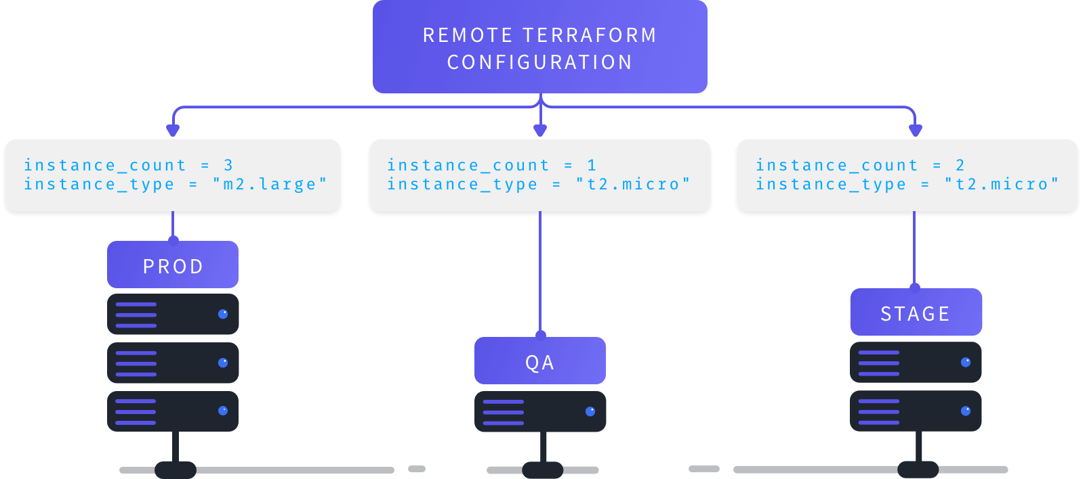
Terragrunt

Slide 17
Terragrunt Basics
Hands On
Notes:
05-terragrunt

Slide 18
Aufgabe
Create a parent terragrunt.hcl file that contains variables for both environments.
This parent terragrunt.hcl should include the containers variable in an inputs block (identical to the environment-specific terragrunt.hcl files).
The variable in the parent terragrunt.hcl should contain only one container, which will be deployed in both Test and Prod environments.
Include the parent terragrunt.hcl in each environment-specific terragrunt.hcl file.
The include should support variable merging, meaning that if a variable is defined in both terragrunt.hcl files, it should be merged or extended.
The Terraform block should be defined only in the parent terragrunt.hcl file.
Notes:
05a-terragrunt

